Slide 1

Quality and results of meta-analyses on crop diversification
DiverImpact task 1.3
Damien Beillouin, Tamara Ben-Ari, David Makowski

Slide 2




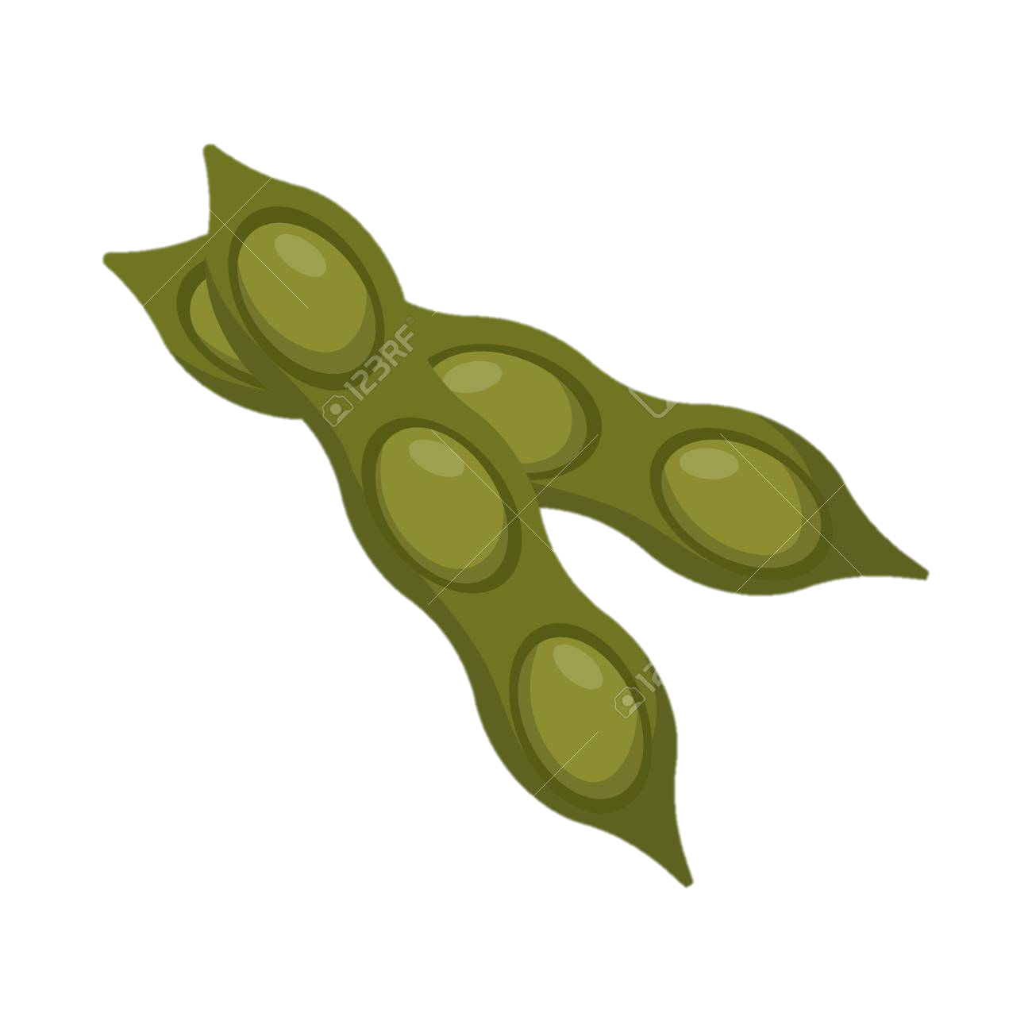

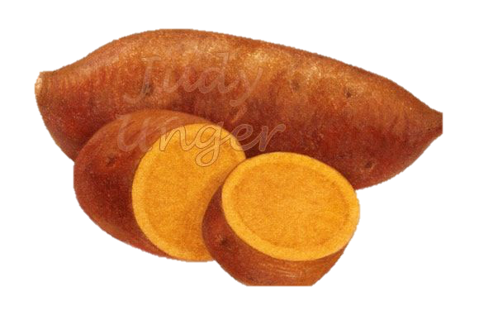
Crop diversification around the world
83 COUNTRIES (with > 5 individual experiments)
6231 EXPERIMENTS
# exp.
138 META-ANALYSES
USA …………. 1491
China…………536
Canada………324
Nigeria……….315
India…………..274
Germany……… 226
Kenya……………198
# of exp.- Meta-analyses
299 SPECIES
(studied in > 5 exp.)
7 DIVERSIFICATION STRATEGIES
Zea mays ………………1936
Triticum aestivum….1307
Glycine max…………...758
Hordeum vulgare…...484
Vigna unguiculata………..274
Secale cereale……….…… 361
Pisum sativum ……………347
% of world cult. areas
In the literature
Beillouin D., Ben-Ari T., Makowski D.

Slide 3
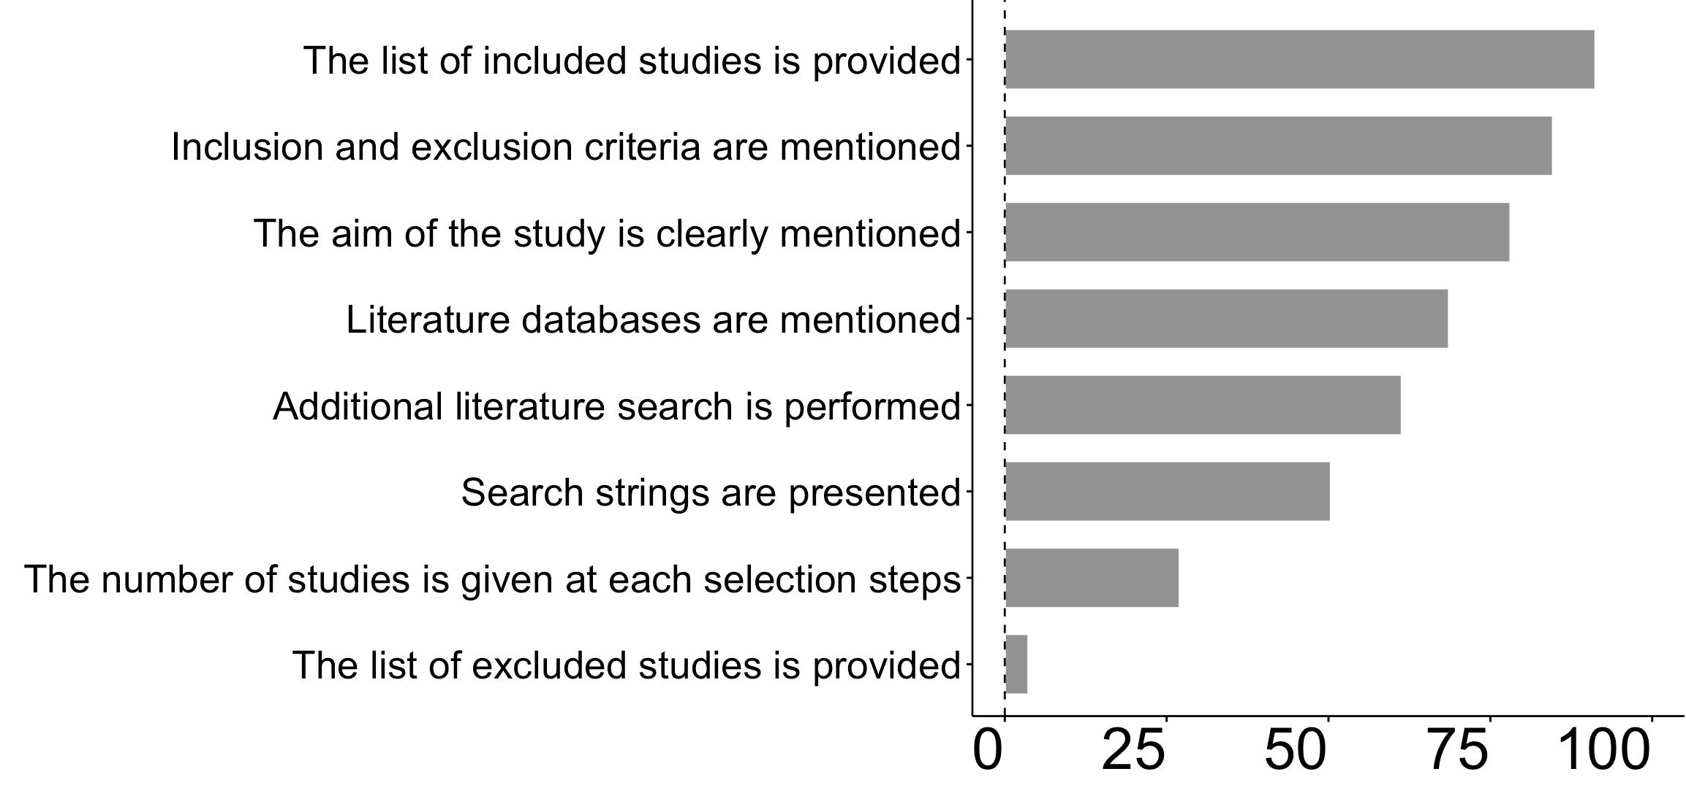
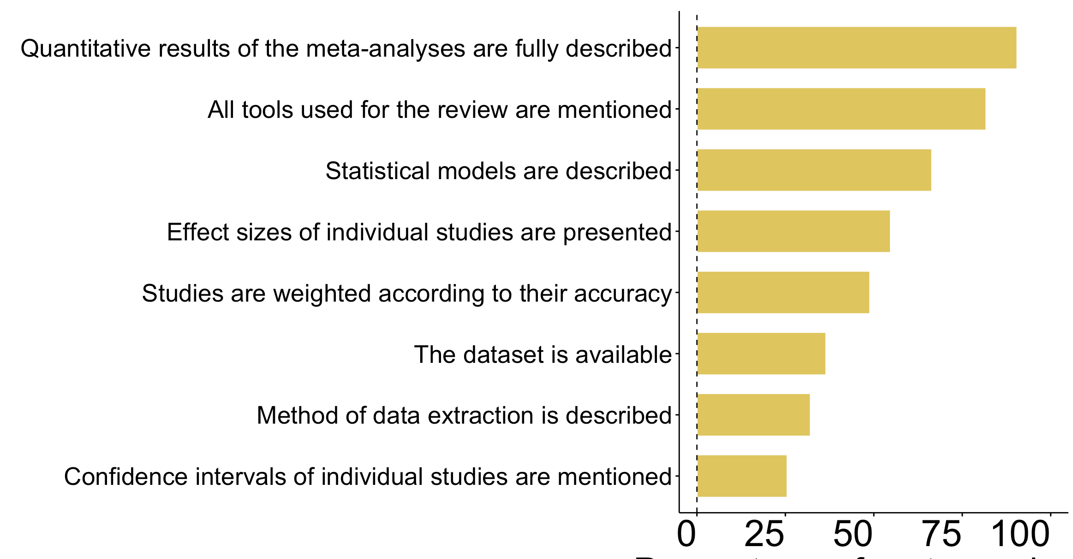
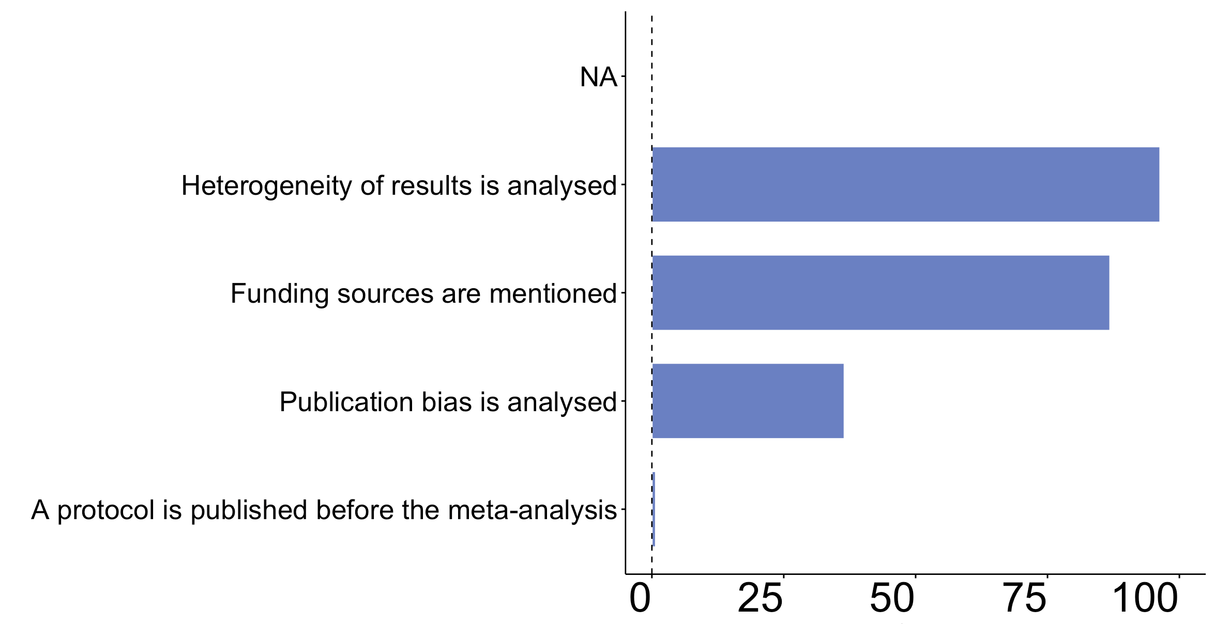
MODERATE BUT IMPROVING QUALITY of the meta-analyses
REVIEW CRITERIA
STATISTICAL CRITERIA
# of Effect_sizes
% of Meta-analyses
% of Meta-analyses
BIAS CRITERIA
EVOLUTION OF QUALITY CRITERIA
% of Meta-analyses

Slide 4
Crop diversification : STILL NUMEROUS KNOWLDGE GAPS
AN UNEVEN KNOWLEDGE
DETAILS FOR SOIL QUALITY CATEGORY
Knowledge gap
# of Effect_sizes
DETAILS FOR PESTS AND DIS. CATEGORY
Rm: 1 Effect_sizes can synthethized hundreds of experiments

Slide 5
Crop diversification : EVER HIGHER REDUNDANCY
% of COMMON EXPERIMENTS
SOME META-ANALYSES with > 50% common experiments
100
Each point= a comparison
of 2 meta-analyses
% of common experiments
50
0
2000
2020
Publication year

Slide 6
Crop diversification : NUMEROUS BENEFITS
OF CROP
DIVERSIFICATION
ALL diversification strategies together
HIGHER
FOR MORE DIVERSIFIED SYSTEMS
LOWER
Profitability
Production
Input use eff.
Soil quality
Biodiv. Assoc.
GHG emision
Water quality
Productrs quality
Water efficiency
Pests regulation

Slide 7
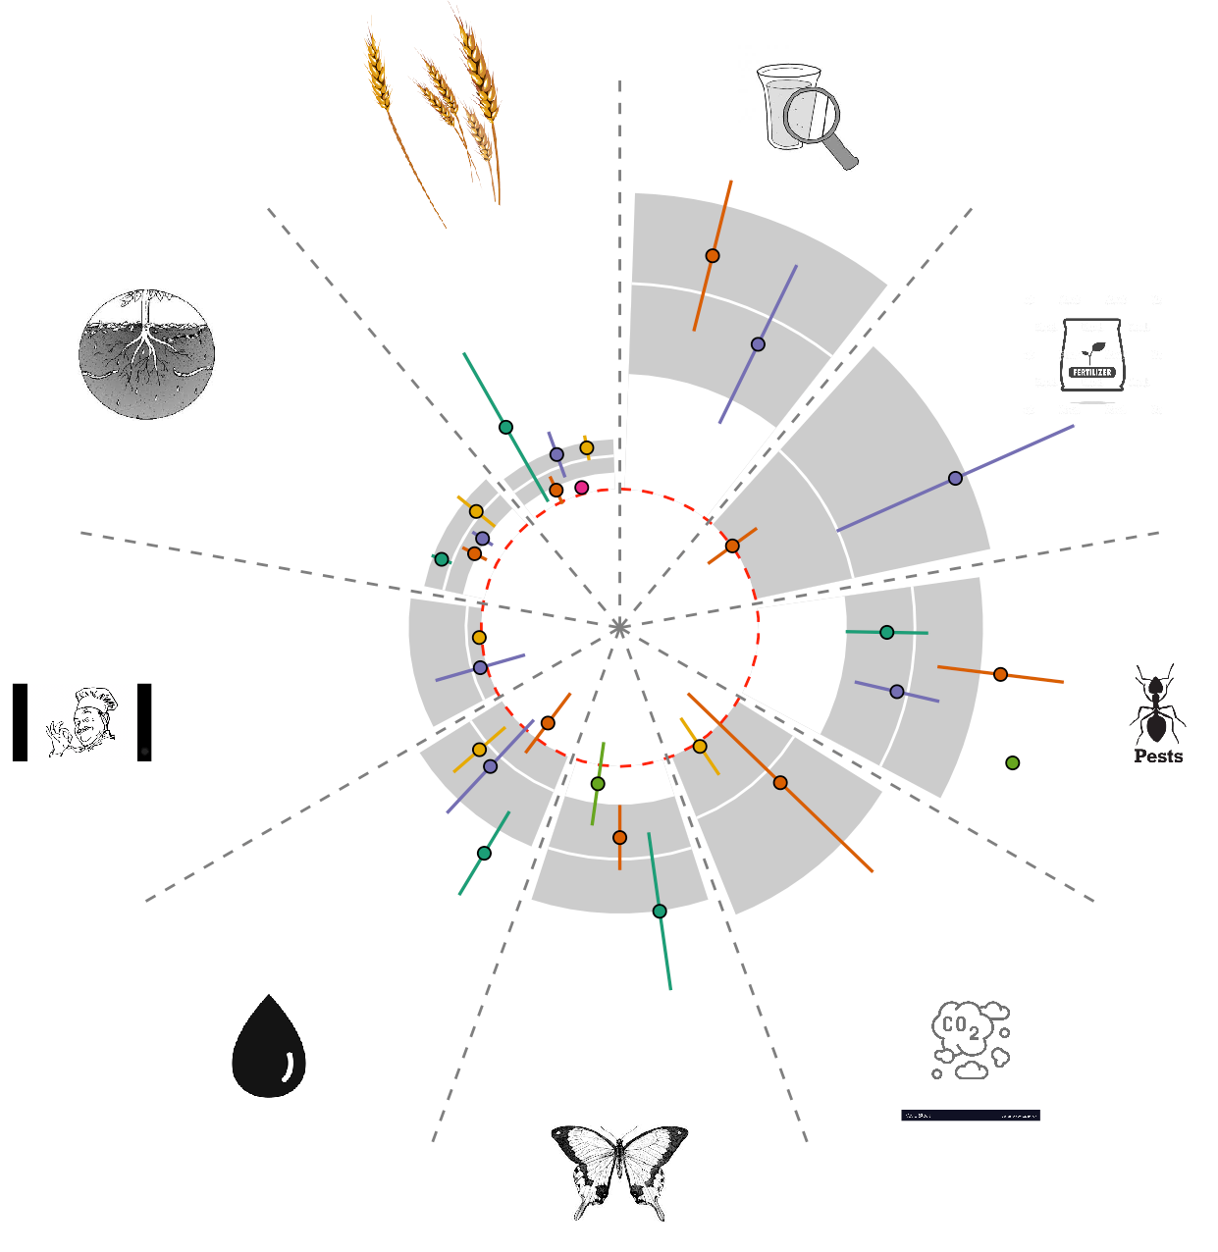
Crop diversification : NUMEROUS BENEFITS
at
Production
Water quality
Value of the outcome:
Higher
In the diversified system compared to the less diversified one
1
0
Equal
Soil Quality
Lower
Input use
efficiency
Diversification strategies :
0
All together:
Higher CI
Mean effect-size
Product
quality
Pests and
diseases
regulation
Lower CI
Individually:
Agro-forestry
Associated plants
Intercropping
Crop mixture
Others
Rotation
Water use
efficiency
Greenhouse gas
emission
Biodiversity

Slide 8
Quality and results of meta-analyses on crop diversification
DiverImpact task 1.3
Damien Beillouin, Tamara Ben-Ari, David Makowski

